Slide 1
Microinsurance Reinsurance Pool
By Gopalakrishnan Kumar, MTech IIT-Bombay,
Freelance Data Science Consultant
LinkedIn: Profile Link : https://www.linkedin.com/in/gopalakrishnankumar-a73301110/
Github:https://github.com/Gopal21236/
Kaggle URL- https://www.kaggle.com/gopalkk2

Slide 2
Google Colab URL
https://colab.research.google.com/drive/1qdEdtyEVsMSrmPRNi7h9ufNQg2gVm3-8?usp=sharing

Slide 3
Executive Summary
Microinsurance products serve low-income and rural populations, providing affordable protection against crop failure, health emergencies, livestock loss, and life events. However, these portfolios are highly sensitive to systemic risks such as weather shocks, disease outbreaks, and regional economic instability.
This project develops a Microinsurance Reinsurance Pool Model that simulates pooled premium collection, claim payouts, loss ratio calculation, and excess-of-loss reinsurance structuring. The framework enables insurers to evaluate sustainability, capital adequacy, and risk-sharing mechanisms.

Slide 4
Business Problem Statement
The simulated dataset includes:
Region (North, South, East, West, Central)
Policy Type (Crop, Health, Livestock, Life)
Premium Amount
Sum Insured
Claim Probability
Claim Occurrence
Claim Amount
This structure reflects real-world microinsurance risk pools with diversified but correlated exposures.

Slide 5
Risk Pool Modeling Framework
3.1 Premium Aggregation
Total Premium Collected = Sum of all individual policy premiums
Represents the capital buffer available before reinsurance.
3.2 Claims Estimation
Claims are simulated using:
Claim Occurrence = Binomial Distribution
Claim Amount = Sum Insured × Severity Factor
This introduces stochastic variability in loss behavior.

Slide 6
Risk Pool Modeling Framework
3.3 Loss Ratio Calculation
Loss Ratio = Total Claims Paid / Total Premium Collected
Interpretation:
< 1 → Profitable / Sustainable
= 1 → Break-even
1 → Underpricing or high-loss exposure
Loss ratio is the primary sustainability metric of the microinsurance pool.

Slide 7
Reinsurance Layer Structure
The model applies an Excess-of-Loss Reinsurance Structure:
Retention Limit: ₹5,000,000
Any aggregate claims exceeding retention are transferred to reinsurer
Reinsurance Claim Amount =
Max(0, Total Claims – Retention Limit)
This protects the pool from catastrophic accumulation risk.

Slide 8
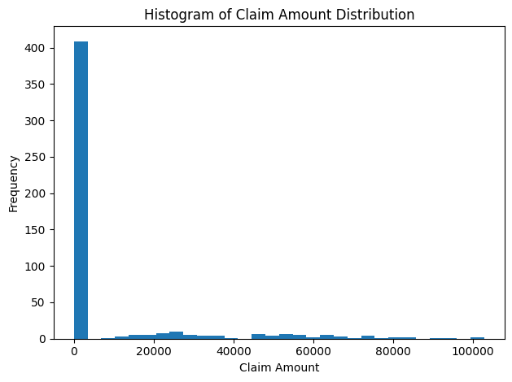
Data Visualization

Slide 9
Visualization & Analytical Insights
5.1 Histogram – Claim Amount Distribution
Shows skewed distribution with many small claims and few large losses.
Business Insight:
Microinsurance pools experience high-frequency low-severity losses with occasional tail-risk events.

Slide 10
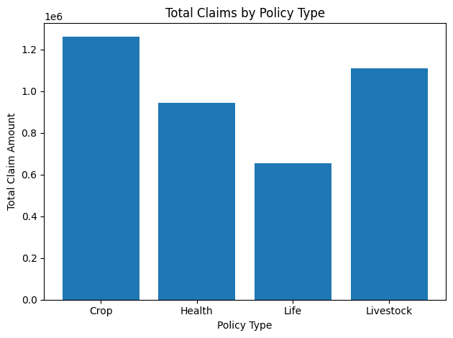
Data Visualization

Slide 11
Visualization & Analytical Insights
5.2 Bar Chart – Claims by Policy Type
Highlights which product drives higher loss exposure.
Typical Insight:
Crop insurance may show higher volatility due to weather risk.
Health insurance may show stable but frequent payouts.
Supports product-level reinsurance pricing.

Slide 12
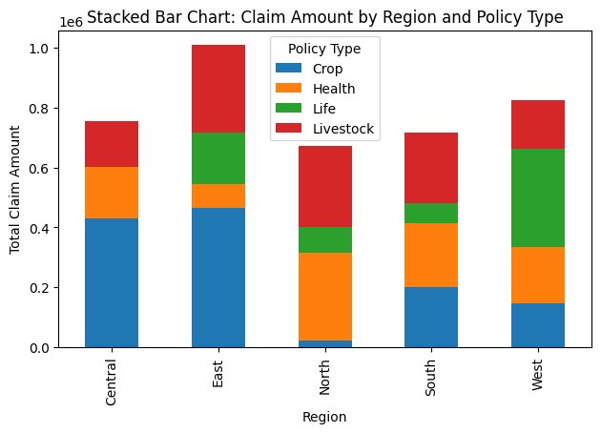
Data Visualization

Slide 13
Visualization & Analytical Insights
5.3 Stacked Bar Chart – Region vs Policy Type
Reveals:
Regional claim concentration
Product dominance within specific geographies
Business Value:
Identifies diversification gaps and concentration risk.

Slide 14
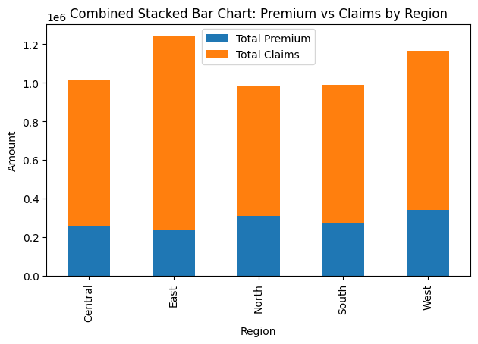
Data Visualization

Slide 15
Visualization & Analytical Insights
5.4 Combined Stacked Bar Chart – Premium vs Claims by Region
Executive-level comparison of:
Capital inflow (Premium)
Capital outflow (Claims)
Strategic Value:
Detects loss-heavy regions
Identifies underwriting imbalance
Supports regional premium adjustments

Slide 16
Key Insights
Microinsurance portfolios are highly sensitive to regional concentration risk.
Crop and health products typically drive the majority of claims.
Loss ratio volatility requires structured reinsurance layering.
Excess-of-loss protection stabilizes capital exposure.
Regional imbalance can significantly impact sustainability.
Diversification across policy types improves pool resilience.
High-frequency low-value claims define operational cost structure.
Tail-risk exposure necessitates reinsurance backing.
Pooling improves solvency stability compared to isolated portfolios.

Slide 17
Strategic Business Impact
The Microinsurance Reinsurance Pool Model enables:
Sustainable premium pricing
Catastrophe shock absorption
Capital adequacy forecasting
Reinsurance treaty structuring
Portfolio diversification optimization
Regulatory solvency compliance

Slide 18
Alignment with Zetheta Standards
This project demonstrates:
Risk pooling analytics
Quantitative actuarial modeling
Reinsurance strategy simulation
Visualization-driven decision support
Capital risk governance
It reflects enterprise-level risk structuring and portfolio sustainability modeling.

Slide 19
Future Enhancements
To further enhance the model:
Monte Carlo simulation of catastrophic shocks
Climate-linked crop yield risk modeling
Dynamic premium pricing optimization
District-level geospatial heat mapping
Multi-layer reinsurance treaty modeling
Solvency stress testing

Slide 20
Conclusion
The Microinsurance Reinsurance Pool framework provides a structured mechanism for stabilizing low-margin, high-volatility insurance portfolios. By combining risk pooling, loss ratio analytics, and reinsurance layering, insurers can maintain sustainability while expanding financial inclusion.
This model forms a scalable foundation for enterprise-level microinsurance capital management and reinsurance optimization.

